Slide 1
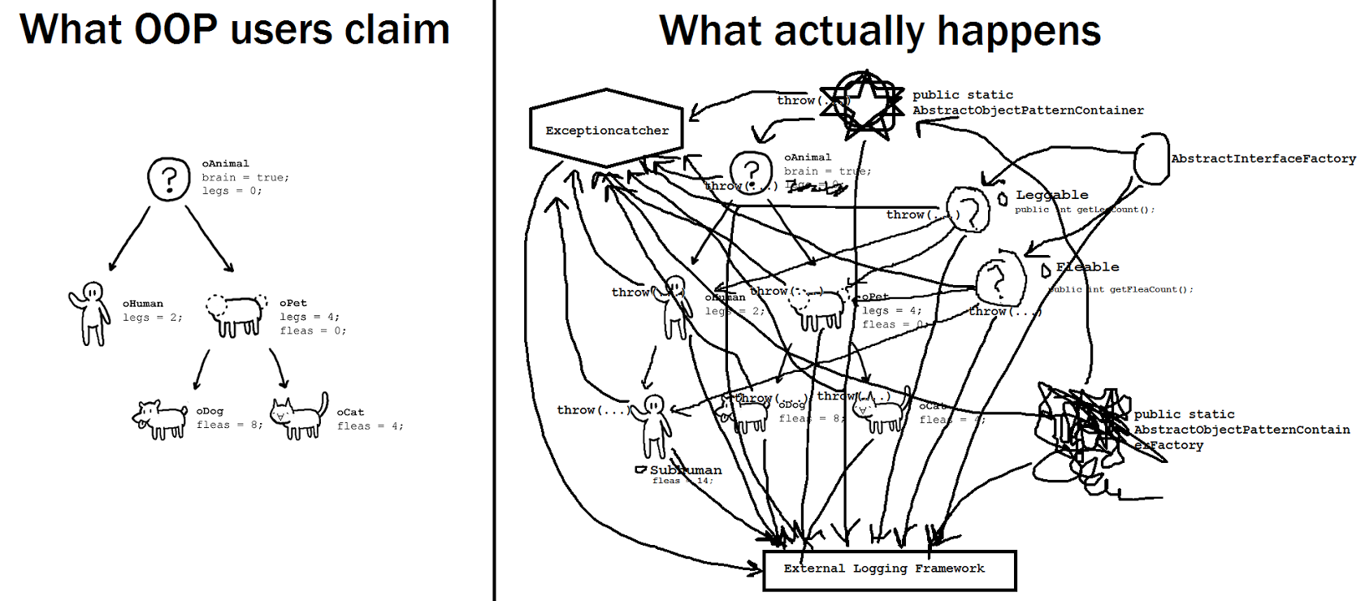
Object Oriented Programming

Slide 2
C# Tutorial Chapter 6
Managing Errors and Exceptions
C# uses “Exceptions to handle “Errors”
Exception Handlers: error-handling code that is
separate from code that implements the primary logic of the program
Exception -aware programs require two things
1. Try Block (“Try” is a C# keyword)
a. Write program code inside of a try block
b. If none of the statements in code generate and “Exception”
then code simply runs to completion
c. If any of the statements in the try block generate an “Exception”
execution jumps out of the try block to the “Catch Handler”
this is called “Throwing an Exception” it is thrown to be caught.
2. Catch Handler (“Catch is a C# keyword)
a. Code designed to catch and handle a specific type of “Exception”’
b. Comes immediately after a try block
c. You can have multiple catch handlers for different “Exceptions”
d. Each one is designed to trap and process a specific “Exception”
e. Programmer appoint the catch handlers, writing several to address
different errors that “could” arise in code, in the try block.
f. Runtimes throws the exception, Then examines the catch handlers
and transfers control to the catch handler that matches the “Exception”

Slide 3
Catch Handler (Catch is a C# keyword)
Catch Handler:
syntax similar to a method to specify the exception to be caught.
Example:
}
Catch (FormatException fEX)
{
//handle the exception
}
The FormatException has several properties used to determine the exact
cause of the exception.
Many of these properties are common to all exceptions
i.e. “message” property: text description of error that caused exception
Unhandled Exception:
When a try block throws an exception and there is no catch handler
To catch it. **Reminder, the programmer must establish the catch handlers
To catch exceptions thrown by errors that He/she thinks might arise,
so an unexpected errors can occur.**
When a FormatException is thrown,
the fEX variable is populated
with an object containing
the details of the exception

Slide 4
Unhandled Exception cont.
A try block throws an exception
Control is transferred to the Catch Block and the runtime attempts to locate
A catch handler that matches the exception that is thrown.
IT the runtime looks but DOES NOT find a catch handler to handle the exception locally
If the try block is part of a method, the method exits and control returns
to the calling method
Then the runtime looks in the try block of the calling method to try and
Find a catch handler for the exception
If the runtime still can’t find a catch handler that works, the calling method
Exits and control returns to the caller.
This process will repeat until a catch handler is located and the handler runs
And execution continues with the first statement that follows the catch
Handler in the catching method
NO CATCH HANDLER is found, the program terminates with an
UNHANDLED EXCEPTION
NOTE** In whatever method that caught the exception, that is where execution
Will continue.
**Using Visual Studios: application stops at the statement that caused
The exception, drop into the debugger. Examine values, change values,and
Step throw your code to troubleshoot.

Slide 5
Using multiple catch handlers
Different errors throw different exceptions, it is best to have as
many catch handlers immediately after your try block that you can
possible think of, the more the better.
Example:
Try
{
int leftHandSide = int.Parse(lhsOperand.Text);
int rightHandSide = int.Parse(rhsOperand.Text);
int answer = doCalculation(leftHandSide, rightHandSide);
result.Text = answer.ToString();
}
Catch(FormatException fEX)
{
……
}
Catch(OverflowException oEX)
{
……
}
***if one catch handler generates its own exception, even if a catch handler in
The catch block can handle it, it won’t . Control will be returned to the method
that invoked the code.

Slide 6
Catching multiple exceptions
The exception-handling mechanism provided by C# and the Microsoft .NET Framework is
quite comprehensive .NET Framework defines many types of exceptions, any program you write
can throw most of them
Exceptions are organized into “families” called “inheritance hierarchies” all exceptions ultimately
derive from
The mother of all families called “EXCEPTIONS”
Using the EXCEPTION as a handler, traps every exception that can occur.
Example:
{
int leftHandSide = int.Parse(lhsOperand.Text);
int rightHandSide = int.Parse(rhsOperand.Text);
int answer = doCalculation(leftHandSide, rightHandSide);
result.Text = answer.ToString();
}
Catch(Exception ex)
}
**when using Exception as a handler you can omit its namefrom the catch handler because it is
the default exception
Catch
{
……..
}
Mother of all Exceptions

Slide 7
What happens if the same exception matches multiple catch handlers at the end of the try block?
When an exception occurs, the runtime uses the first handler it finds that matches the exception
And the others are ignored.
Example:
catch{FormatException Fex)
{
}
catch ( Exception ex}
{
}
**the runtime will run the FormatException handler and ignore the Exception handler.
Which ever one comes first, so it is important to put more “specific handlers first” when using
Multiple exceptions.

Slide 8
Exception filters
Feature used to match exceptions to catch handlers
Enables additional conditions under which the catch handler is used
Conditions take the form of a Boolean expression prefixed by the keyword “when”
Example
Catch(Exception ex) when (ex.GetType() != typeof(System.OutOfMemoryException))
{
// handle all previously uncaught exceptions except OutOfMemoryException
}
The catch example catches all exceptions using the “Exception” handler EXCEPT if an exception is an
System.OutOfMemoryException, the method GetType() within the catch block returns the type of
The variable specified as the argument.When a OutOfMemoryException is thrown, the runtime will
Continue looking for a catch handler that matches and if none are found it will be a
UNHANDLED EXCEPTION and the progam will TERMINATE.

Slide 9
Propagating exceptions
Avoid having to duplicate catch handlers you have already typed in at one point in your code
You write the catch handler code at the end of a try block in your program, then POINT back to “propagate”
Back to the method where the original catch handlers were written, when an exception is thrown in
another section of your program.
Example: addValue() throws an exception in the body of the method. But you also have a subtractValue(),
multiplyValue(),divideValue(), and remainderValue() to write catch handlers for in your code.
You don’t want to rewrite common catch handlers for common exceptions in each one of these methods
..instead you put the try block and the catch handlersin the method CalculateClick() that invokes each
one of these methods individually or “CALLS” one of these methods when the user pushes The “Calculate”
button in your app. So if an exception is thrown in the subtractValue() or one of the mathematical methods
listed, The runtime transfers control to the catch handlers in the CalculateClick() catch block, handling
all exceptions in one place.
Letting a method propagate back to the method that invoked the routine that threw the exception and
handling the Error there, may not always be best practice, depending on the nature of the application.
In that instance:
a try block and The subsequent catch handlers would be written locally within the method that might
Through the exception.

Slide 10
Checked and Unchecked integer arithmetic
Int.MinValue or intMaxValue are used to refer to the minimum or maximum value of an integer
Overflow checking: When an integer variable exceeds its size limit in code, the compiler generates
code that allows the calculation to overflow silently and a wrong answer is generated.
The calculation wraps around to the largest negative integer value
Example
2147483647 is the max size limit for an integer
you attempt to add 1 and the the compile executes overflow,
wraps around to the largest negative integer value
resulting in the answer -214483648.
Overflow is all about performance.
Eliminates the need for overflow checking to be applied to each Individual Integer expression an
instead the compiler responds to cases of overflow when or if they arise.
**Overflow checking can be disable
Visual Studios-go to your project-project menu click project properties-build tab-advanced-uncheck
overflow / underflow box

Slide 11
Writing Checked Statements
Checked statement: a block preceded by the keyword “checked”
A OverFlowException is immediately thrown if an integer calculation in the block overflows.
Example int number = int.MaxValue;
checked
{
int willThrow = number++;
Console.WriteLine(“this won’t be reached”);
}
**Only integer arithmetic directly inside the checked block is subject to overflow checking
Unchecked statement: a block preceded by the keyword “unchecked”
Integer arithmetic within the “unchecked” block will NEVER throw and OverFlowException
Int number = int.MaxValue;
unchecked
{
int wontThrow = number++;
Console.WriteLine(“this will be reached”);
}

Slide 12
Throwing Exceptions
.NET framework class libraries contain lots of exception classes to apply when you want to
intentionally throw an exception in your program.
In most cases the .NET framework class libraries will contain a class that describes your exceptional
condition. If not you can create your own custom exception class( advanced C# language required)
You throw an exception by using the keyword “throw”
Example
Public static string monthName(int month)
{
switch(month)
{
case 1 :
return “January”;
case 2 :
return “February”;
case 12 :
return “December”;
default:
throw new ArgumentOutOfRangeException(“Bad Month”);
}
}

Slide 13
Finally Block
When an exception is thrown it changes the path of execution of the program
Some statements may be excluded and not run due to the change in flow of the program
**reminder: when exception is thrown and handled the program executes the line of code
Immediately after the block that contained the catch handler..NOT where the error occurred.
Sometimes this will not negatively affect your program but it can, if a necessary statement does not
Execute, Especially if that statement released a resource, for instance.
To ensure a statement is executed regardless if exceptions are thrown you put that statement in the
“finally block”:
Placed Immediately after a try block or immediately after a catch block
As long as the program enters the try block associated with the finally block the finally block will run.
When exception is thrown, the catch handler will execute first and then the finally block
If the method containing the finally block does not have the catch handler and control is transferred
Outside the block..the finally block still executes and runs first when the catch handler is
not found locally.

Slide 14
Finally Block Example
Try
{
string line = reader.ReadLine();
while(line != null);
{
line = reader.ReadLine();
}
}
Finally
{
if(reader != null)
{
reader.Dispose();
}
}
The finally block in this example ensures that the reader.Dispose(); method from within the method
Prior to this code block is executed regardless if an exception is thrown within the body of the previous
method

